Slide 1
Session 1
Lions, and Tigers, and A.I. … Oh My!!
Dianne Cmor

Slide 2
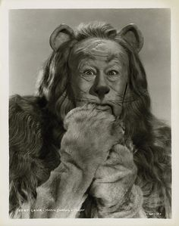
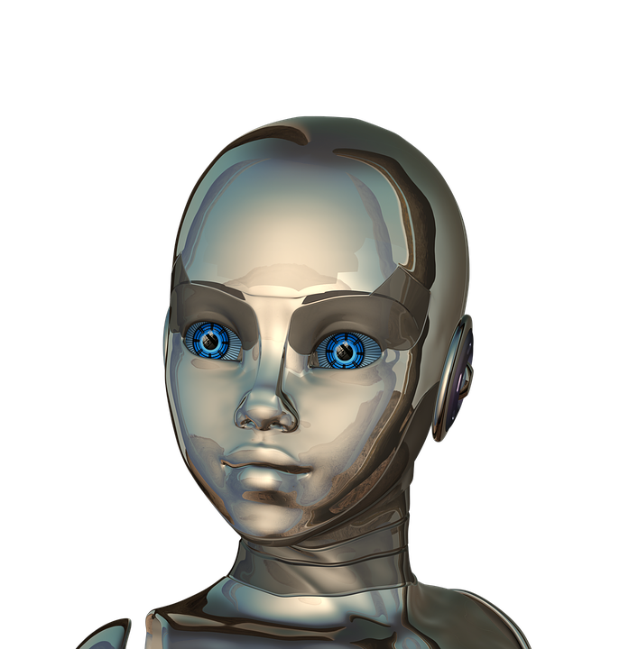
Lions, and Tigers, and AI … Oh My!
Dianne Cmor
HKUL Library Leadership Institute 2018, Hong Kong

Slide 3
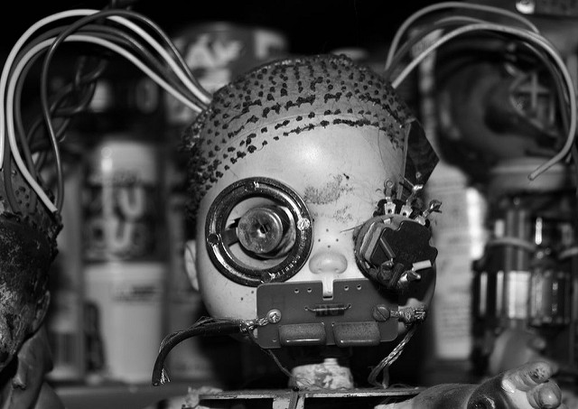
Exercise #1 TSE Questionnaire
https://www.flickr.com/photos/bistrosavage/3774175

Slide 4
Exercise #1 TSE Questionnaire - Warm up
How certain are you that you would be able to lift each of the weights listed below?
Rate your degree of confidence:
0 1 2 3 4 5 6 7 8 9 10
Cannot do Moderately Highly certain
at all certain can do can do
____ Lift a 5 kg object above your head
____ Lift a 20 kg object above your head
____ Lift a 50 kg object above your head

Slide 5
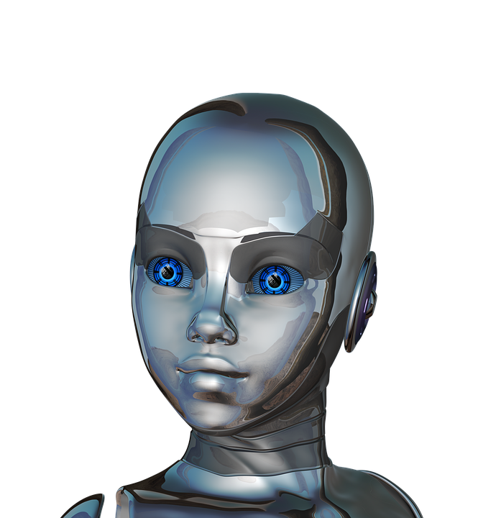
Are we prepared?
Gaming apps
Internet of things
Blockchain
Artificial intelligence
Data visualization
Adaptive learning
Digital scholarship
Linked data
Algorithmic literacy
https://pixabay.com/en/girl-woman-face-eyes-close-up-320262/

Slide 6
Walking the Walk of Lifelong Learning
https://www.flickr.com/photos/xerones/141357725/

Slide 7
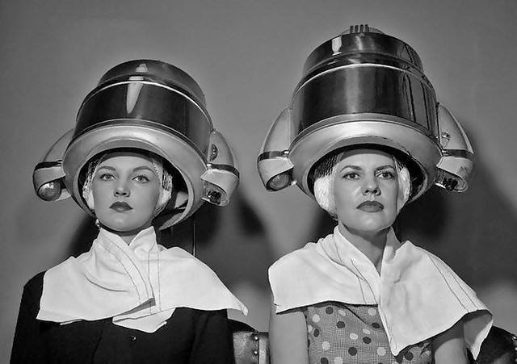
Exercise #2 How do you/we learn?
https://www.flickr.com/photos/x-ray_delta_one/3861339752/
https://www.flickr.com/photos/x-ray_delta_one/3861339752/
https://www.flickr.com/photos/x-ray_delta_one/3861339752/
https://www.flickr.com/photos/x-ray_delta_one/3861339752/
https://www.flickr.com/photos/x-ray_delta_one/3861339752/

Slide 8
Professional Development Approaches
Learning journals
Learning circles
Journal clubs
In-house learning
Online learning
Current awareness tools
Research culture
Technology culture
. . .
https://www.flickr.com/photos/garlandcannon/6090983235/

Slide 9
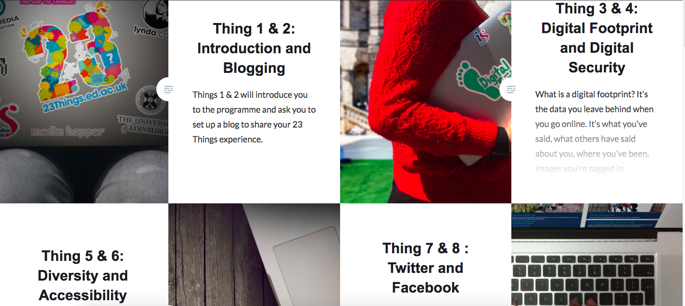

Slide 11
Professional Curiosity
https://www.flickr.com/photos/kimdokhac/5117550155/

Slide 12
Thanks for playing!
Dianne Cmor
HKUL Library Leadership Institute 2018, Hong Kong

